Slide 1
Starting at 12:05!
Please turn on your cameras and feel free to talk in the chat!

Slide 2

Tutorial 6
MORE DETAILS ABOUT APIS

Slide 3
HTTP Protocol: The Language of the Web
HTTP protocol acts as the set of rules that computers follow when they are interacting with one another.
Example: Suppose we are in a checkout line in a grocery store. The set of rules we have to follow when checking out are that we need to wait until the person in front of us has finished before we can begin the checkout process.
When computers communicate with one another they must make sure that they are following the correct set of instructions(http protocol).

Slide 4
Clients and Servers
What is a client? Going back to our restaurant example, it is the customer! In other words, the client is the program that requests some information from an API.
What is a server? A server is just a really big computer that “listens” for requests and sends out appropriate responses (or “serves” them). It contains the API, database and any other code needed. It really is just a big computer!

Slide 5
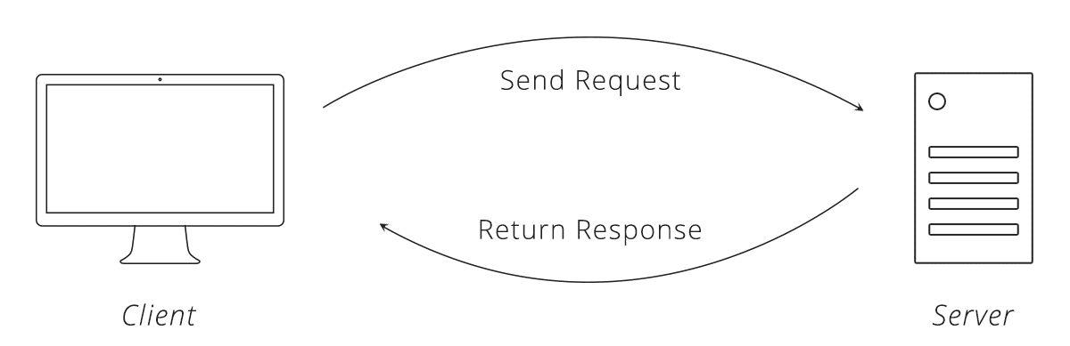
HTTP Requests - The Ettique of the Programming World
One of the most significant concepts in communication between computers using HTTP protocol is the Request-Response cycle
When a client makes an HTTP request to a server, the server sends bake an HTTP response.

Slide 6
HTTP Request
Made up of 4 parts: URL, Method, list of Headers, Body
URL is the unique address for an item on the web
Methods: Get, Put, Post, Delete
Headers is a summarization of what we are trying to do
Body contains the list of information that we want to send the server

Slide 7
HTTP Request Methods
Get: asks the server to get the resource
Post: asks server to create a new resource
PUT - Asks the server to edit/update an existing resource
DELETE - Asks the server to delete a resource
A resource refers to some sort of information on the server, such as a birthday, your favorite song, etc.
Example

Slide 8
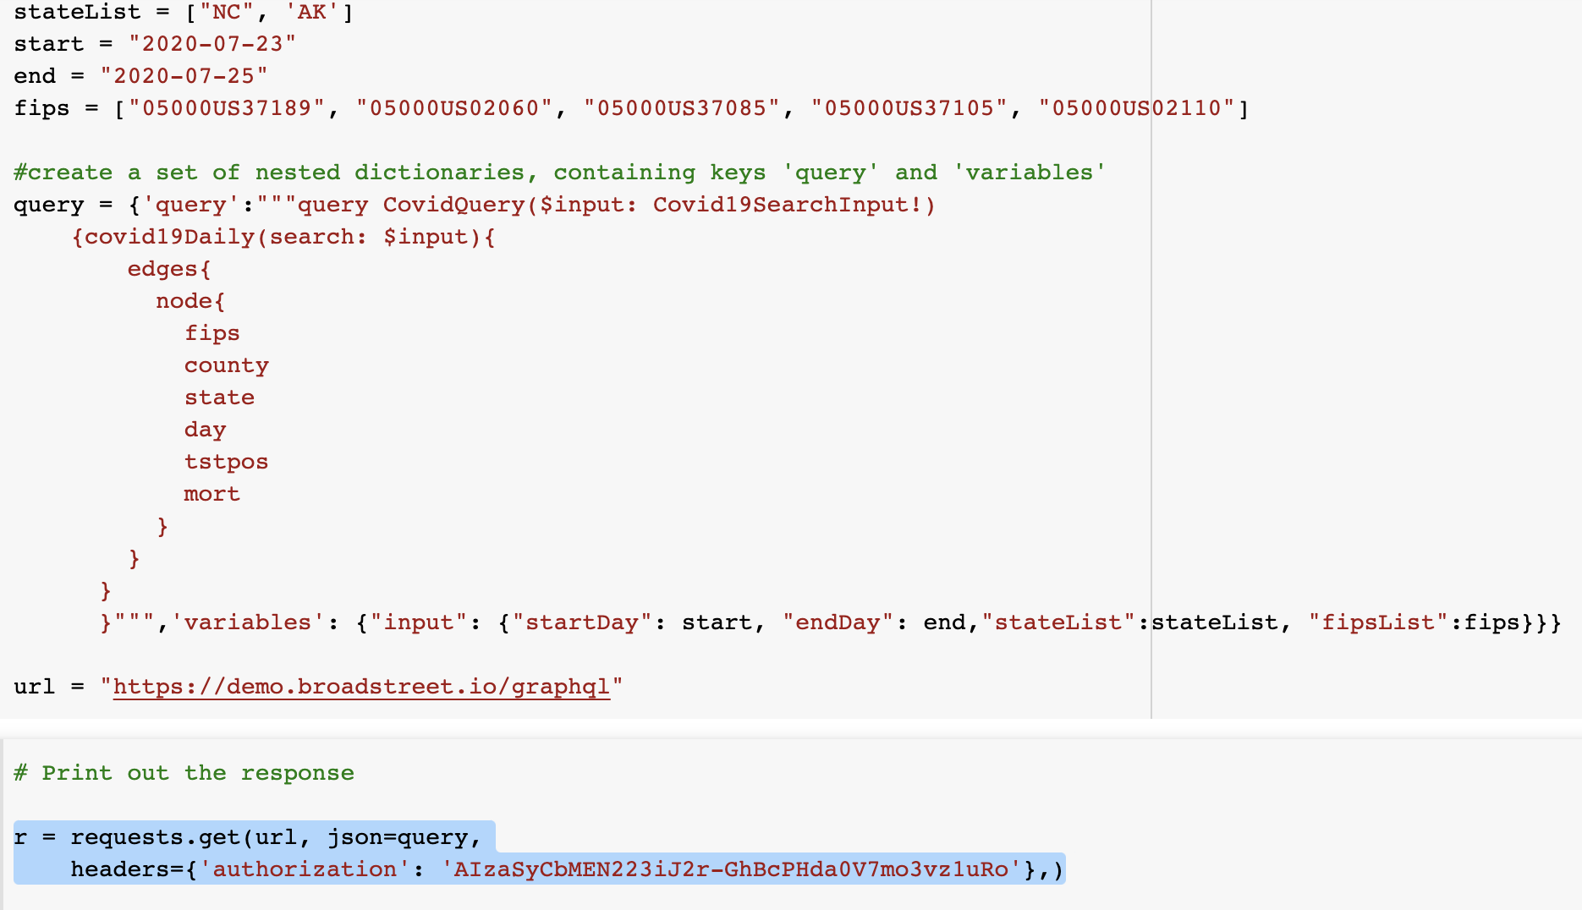
What does it look like?

Slide 9

API(Application Programming Interface)
An API is a way that two applications can talk to each other and transfer information
API is a tool that make a website’s data accessible for another computer

Slide 10
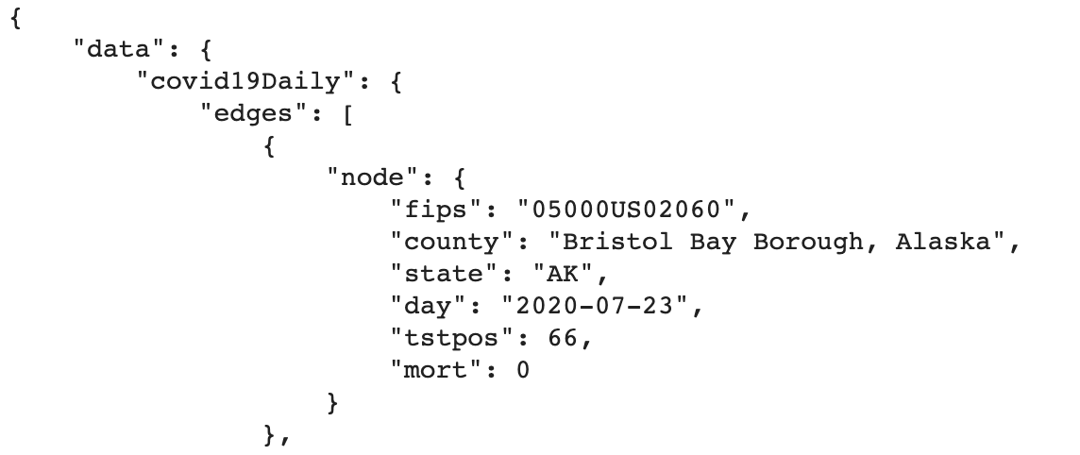
HTTP Response(Using an API)
When a HTTP response is sent to the client, the data that comes in the response is formatted in a nice accessible format such as JSON
Example:

Slide 11
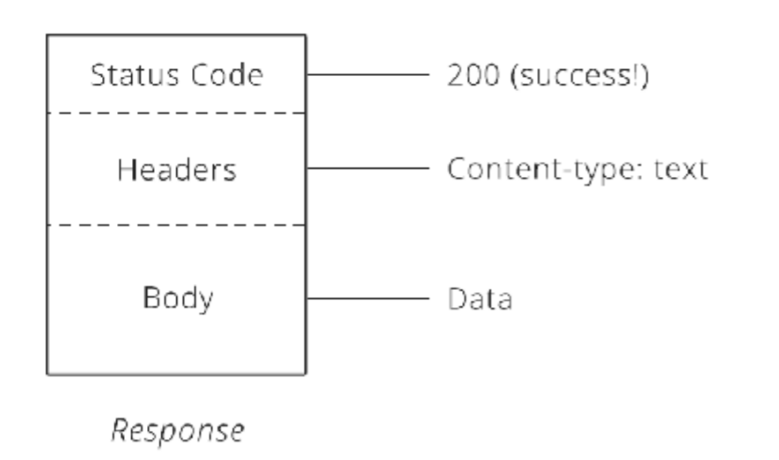
HTTP Response Structure
Very similar to the request structure
Instead of a method or a URL, we instead send a statsu code. The response body and header follow the same format.

Slide 12
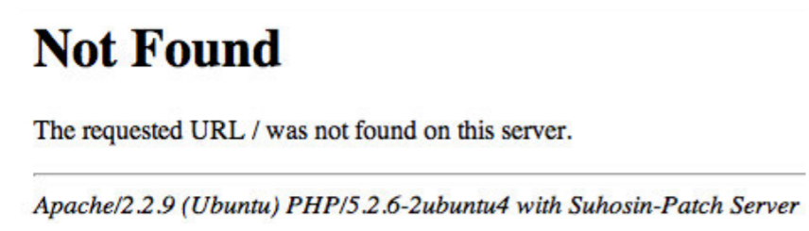
Status Codes
3-digit numbers that have a unique meaning. This can send more information back to the client if used currently.
For example: the infamous 404 error. Let’s break this down with the knowledge that we gained!

Slide 13
Summary
Using an API, we send a request to a server. Depending on what method, headers, and body we use, the server then sends us a response(for us it is in JSON format) and with the two systems communicating we can obtain the information we want.

Slide 14
Non-Coding Example
Zapier Demo
Here, we will demonstrate a small “Zap” or set of actions I created to help facilitate this course. This is an extremely simply explanation of how API’s can work.
IFTTT Demo
An even, simple example of how an API works, that is one step. We will leave this for you to explore and will not do a full demo on this topic.

Slide 15
API’s and Where To Find Them
Google!
Most API documentation should contain examples of sending requests to an API. If they don’t, well….
Github!
Github contains lots of examples on API’s and using them. It’s also really awesome for looking at examples of other functions you might want to use but don’t know how to.
StackOverflow!
The literal lifesaver of developers everywhere. Contains answers to most of the questions you’ll have and is sorely needed by all professional developers. Seriously cannot understate how much this is useful and how much of the internet runs off of StackOverflow code.

